Slide 1
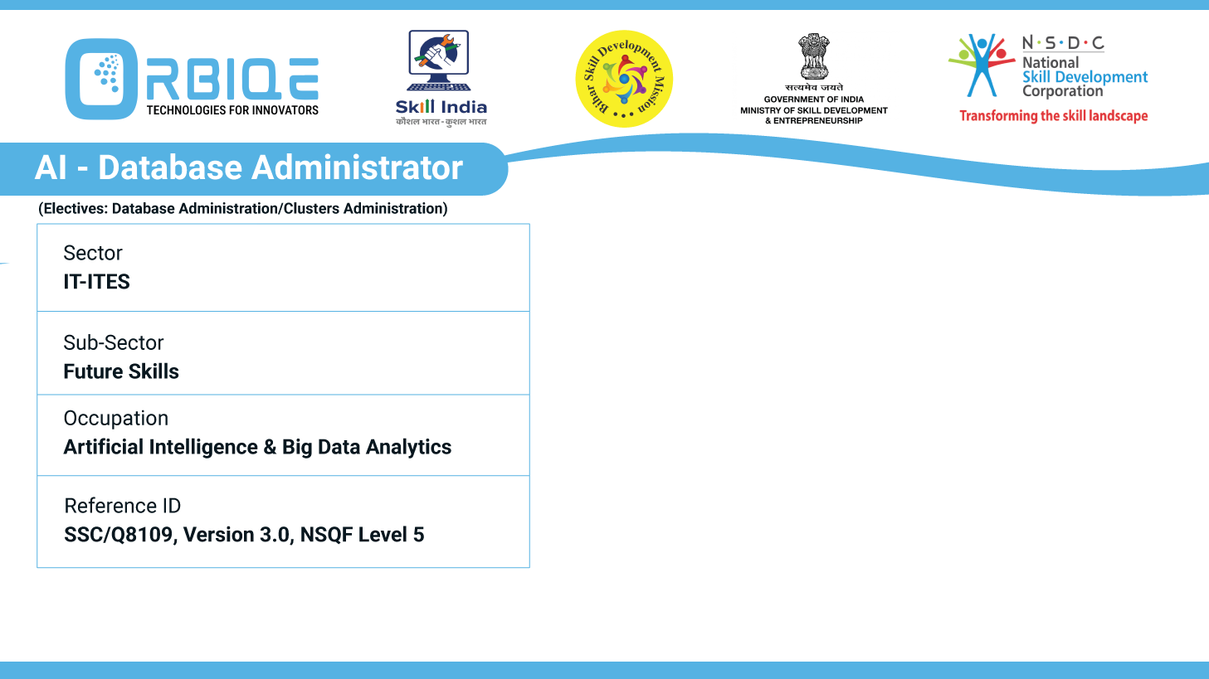
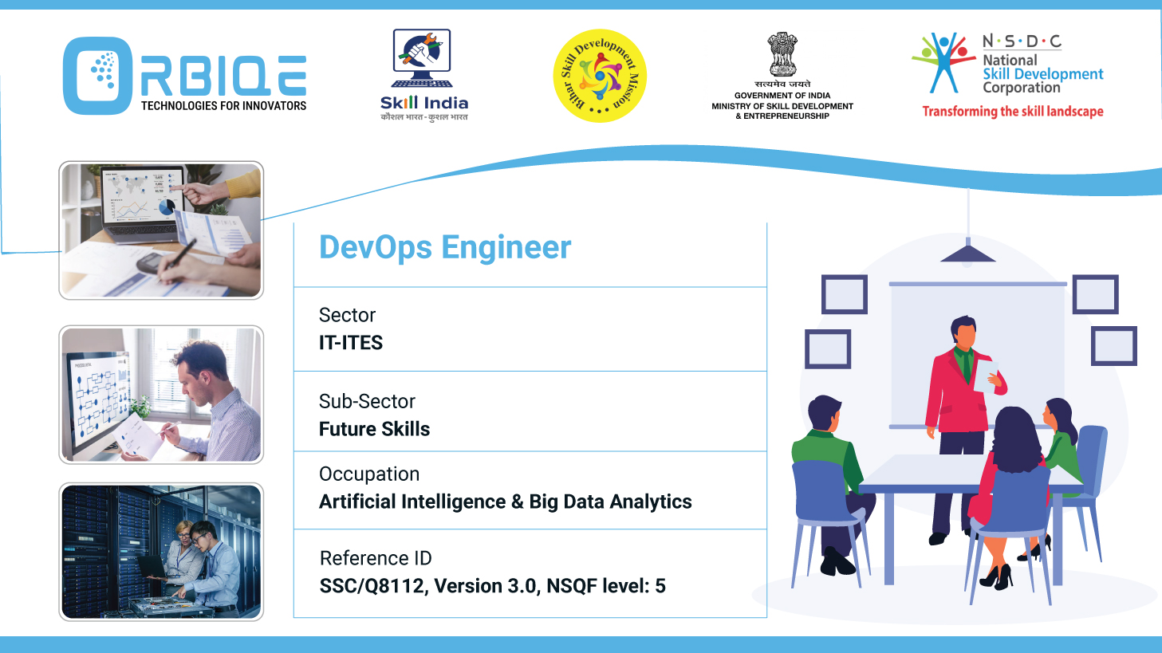
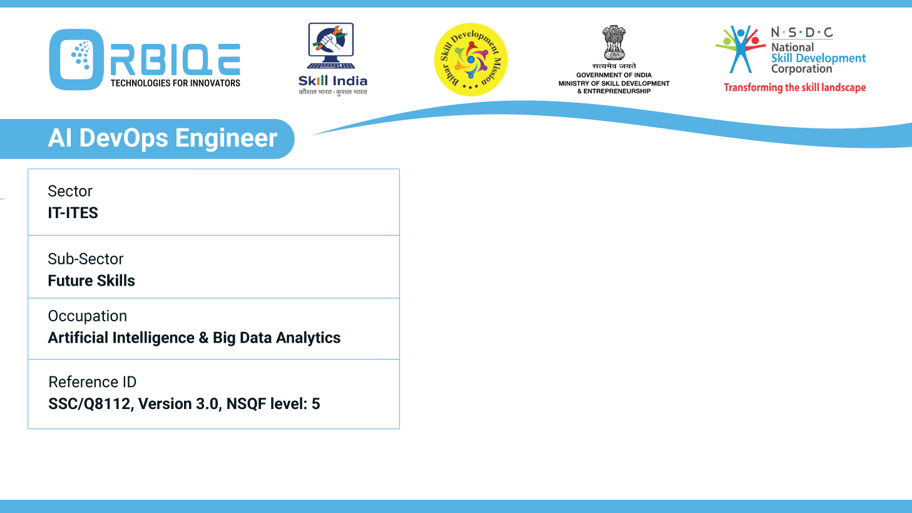
Name- Krishna Kant Dubey

Slide 2

Data Governance Essentials: Ensuring Quality and Compliance

Slide 3
Agenda
Establish the importance of data governance in maintaining data quality and compliance
Compliance, emphasizing best practices for effective AI Database Administration

Slide 4
What Is Data Governance?
Data governance is the framework of policies, procedures, roles, and standards that guide how data is managed, accessed, and used across an organization.
It ensures that data remains accurate, secure, and compliant throughout its lifecycle

Slide 5
Establishes Standards
Defines what “good” data looks like—accuracy, completeness, consistency, and timeliness.
• Sets metrics and benchmarks for evaluating data quality.

Slide 6
Assigns Responsibility
Designates data owners and stewards to oversee data quality in specific domains

Slide 7
Enforces Processes
Implements procedures for data validation, cleansing, and monitoring

Slide 8
Regulatory Adherence
Helps meet legal requirements like GDPR, HIPAA, and CCPA by enforci
ng data privacy and protection policies

Slide 9
Risk Mitigation
Reduces the likelihood of data breaches and non-compliance penalties

Slide 10
Thank You

